Slide 1
Respiratory Implications of COVID-19: A Saskatchewan Perspective
Erika Penz, SM MD MSc FRCPC
Division of Respirology, Critical Care and Sleep Medicine
University of Saskatchewan
Respiratory Research Centre
May 6, 2020

Slide 2
“In a pandemic, the strongest attractor of trust shouldn’t be confidence, but the recognition of one’s limits, the tendency to point at expertise beyond one’s own, and the willingness to work as part of a whole.”
Ed Yong, The Atlantic

Slide 3
Our Reality, Our Challenge
Reality: Modern Expertise tends to be deep but narrow
Challenge: Pandemics demand both breadth and depth of expertise
  To work out if widespread testing is crucial for controlling the pandemic, listen to public-health experts; to work out if widespread testing is possible, listen to supply-chain experts.
  To determine if antibody tests can tell people if they’re immune to the coronavirus, listen to immunologists; to determine if such testing is actually a good idea, listen to ethicists, anthropologists, and historians of science.
The Atlantic,

Slide 4
SARS-CoV-2
The virus, The disease, The Costs

Slide 5
Definitions
Coronavirus is a family of viruses, some of which infect only animals, and others that can infect humans.
Coronaviruses are genotypically and serologically divided into 4 sub-families: α, β, ϒ, δ Co-Vs.
7 strains of coronavirus (α, β )are now known to cause illness in humans.
SARS-CoV-2 is the most recent strain of coronavirus causing illness in humans
Of the 6 others, 4 caused mild illness (cold) and 2 caused serious illness (SARS and MERS)
Most commonly spread through respiratory droplets; close, prolonged personal contact; and touching an infected area, then touching mouth, nose or eyes before washing hands.

Slide 6
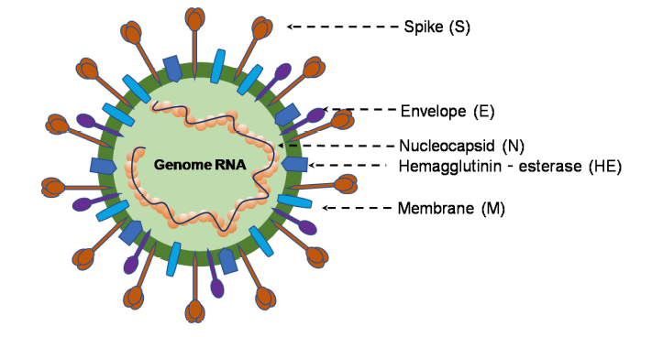
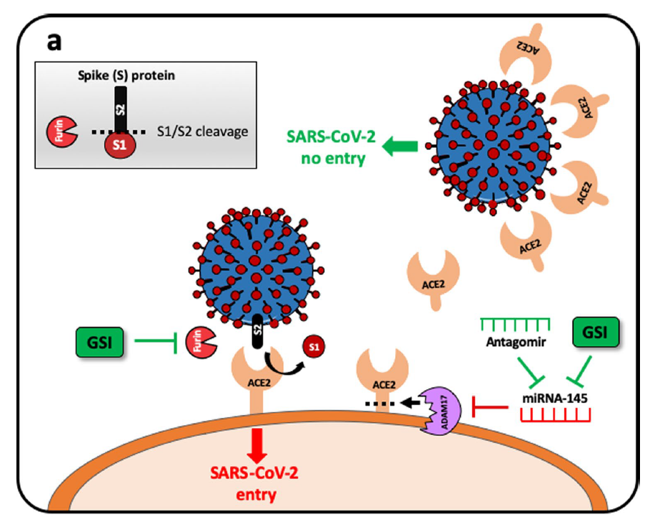
Pathophysiology
Virology
  Class of enveloped, positive-sense single-stranded RNA viruses
Cell entry
  Human angiotensin-converting enzyme 2 (ACE2) is a functional receptor used by SARS-CoV-2 for cell entry
  ACE2 is a membrane protein expressed in the lung, heart, kidney and intestines
  The S proteins of Coronavirus binds to the host cells by ACE2, fusing to the membrane and release the viral RNA
2020 Jin Y. et al
Notes:
Jin Y. et al Virology, Epidemiology, Pathogenesis and Control of COVID-19

Slide 7
Pathogenesis - Proposed 3 stages
Asymptomatic state
SARS COV-2 binds to ACE2 receptors of respiratory mucosa and starts to replicate
Upper airway and conducting airway response
virus propagates down respiratory tract and leads to a more robust innate immune response
for most this is self limiting
Hypoxemia, GGO and ARDS
virus reaches the alveoli and infects alveolar type II cells
this leads to cell death apoptosis and cytokine storm
ERS 2020 Robert J. Manson

Slide 8
What happens in the lungs?
Proposed mechanism for lung injury cases by the SARS-CoV-2 is the cytokine storm
Triggered by an imbalanced response of type 1 and type 2 T helper (Th) cells
Interleukins and TNF-alpha are involved in the cytokine storm
  Stimulate production of acute phase proteins

Slide 9
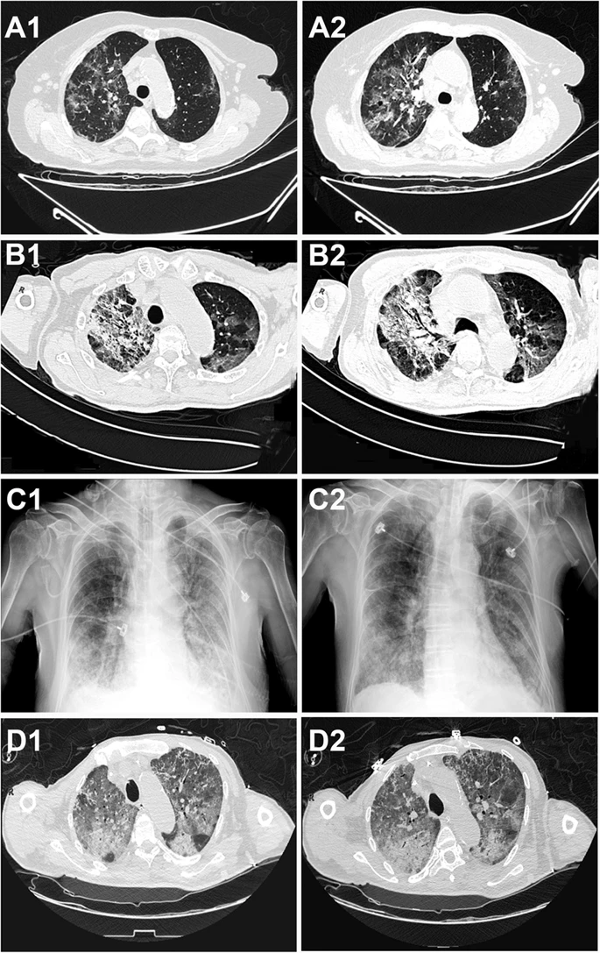
Histopathology and Radiological findings
Acute phase DAD (diffuse alveolar damage)
  sloughing of pneumocytes and type II pneumocyte hyperplasia
  hyaline membrane formation
  vascular congestion
  inflammatory cellular infiltration
Organizing phase DAD
  Hyaline membrane
  Alveolar hemorrhages
  Interstitial thickening
  Necrosis of vessel walls
  Neutrophilic infiltration
Tian, S., Xiong, Y., Liu, H. et al. Pathological study of the 2019 novel coronavirus disease (COVID-19) through postmortem core biopsies. Mod Pathol (2020). https://doi.org/10.1038/s41379-020-0536-x

Slide 10
Clinical Presentation
Signs and symptoms appear 2-14 days after exposure
WHO-China Joint Mission on COVID-19

Slide 11
Disease Severity
Asymptomatic | Positive SARS-CoV-2 PCR without symptoms
Mild Illness | Signs and symptoms (e.g. fever, cough, sore throat, etc.) without dyspnea or imaging abnormalities
Moderate Illness | Evidence of lower respiratory disease by clinical assessment or imaging and oxygen saturation >93% on room air
Severe Illness | Respiratory rate >30 breaths per minute, SpO2 ≤93% on room air, PaO2/FiO2 <300, lung infiltrates >50%
Critical Illness | Respiratory failure, septic shock, or multiple organ dysfunction
80%
15%
5%
National Institute of Health COVID-19 Treatment Guidelines

Slide 12
Prognostic Factors
Variable | Odds death
Age | 1.1 (1.1-1.2)
COPD | 5.4 (1.0-30)
CAD | 21.4 (4.6-98.8)
Diabetes | 2.9 (1.4-6.1)
Hypertension | 3.1 (1.6-5.9)
Respiratory Rate >24 | 8.9 (4.3-18.2)
Variable | Odds death
WBC >10 | 6.6 (3.0-14.4)
Lymphocyte x 10⁹/L | 0.02 (0.01-0.08)
ALT >40 | 2.9 (1.5-5.6)
Cr > 133 | 4.4 (1.0-19.1)
CK >185 | 2.6 (1.0-6.4)
hs-TnI | 80 (10.3-620.4)
Zhou et al. (2020). The Lancet.

Slide 13
Important Epidemic/Pandemic terms
Epidemic: an increase in the frequency of occurrence of a disease in a population above its baseline, or expected level, in a given time period.
Pandemic: Outbreak of disease over a wider geographic area and population
Basic reproduction number (R₀)
The basic reproduction number (R₀) is used to measure the transmission potential of a disease.
Average number of secondary infections produced by a typical case of an infection in a population where everyone is susceptible.¹.
R₀ is affected by several factors:
  The rate of contacts in the host population
  The probability of infection being transmitted during contact
  The duration of infectiousness.
In general, for an epidemic to occur in a susceptible population R₀ must be >1, so the number of cases is increasing.¹
Effective reproductive number (R)
A population will rarely be totally susceptible to an infection in the real world.
R is the average number of secondary cases per infectious case in a population made up of both susceptible and non-susceptible hosts.
R is affected by several factors:
  prior infection conferring life-long immunity,
  previous immunization.
  Mitigation measures in place in the population (physical distancing, closure of schools/business)
R is usually less than R₀
If R>1, the number of cases will increase, such as at the start of an epidemic. Where R=1, the disease is endemic, and where R<1 there will be a decline in the number of cases.

Slide 14
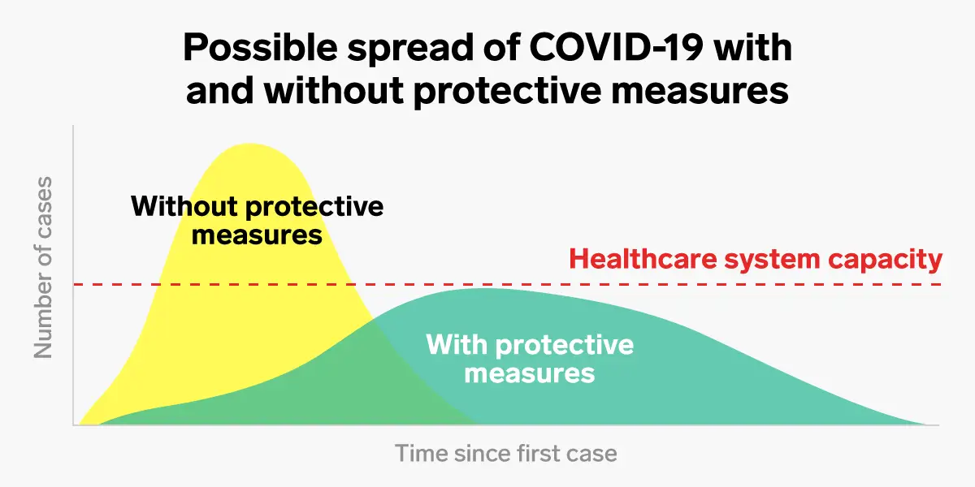
Why is this important?

Slide 15
Coronavirus Disease 2019. Daily Epidemiological Update. May 3, 2020

Slide 16
Summary of COVID-19 cases reported in Canada as of May 3, 2020
Coronavirus Disease 2019. Daily Epidemiological Update. May 3, 2020
Notes:
As of May 3, 2020, 57, 148 cases (1576 new cases), including 3606 deaths (160 new deaths) have been reported in Canada. Overall case fatality rate is 6.3%.
At least 893,490 people have been tested for COVID-19, corresponding to a test rate of 23,770 per million population

Slide 17
Coronavirus Disease 2019. Daily Epidemiological Update. May 3, 2020

Slide 18
Possible exposure setting of COVID-19 cases reported in Canada
Coronavirus Disease 2019. Daily Epidemiological Update. May 3, 2020
Notes:
From an exposure setting point of view, and of the 30,721 cases with detailed information, 70% of cases reported in the country are community related with 17% now travel related. Of those with community-related exposures, the majority were unknown, 19% were exposed in a healthcare facility with 2% in a long-term care facility.
What this highlights is that unlike much earlier in the pandemic, the risk of exposure to the virus and the efforts to mitigate risk have needed to evolve over time in order to attenuate the spread of the virus.

Slide 19
Saskatchewan Experience

Slide 20
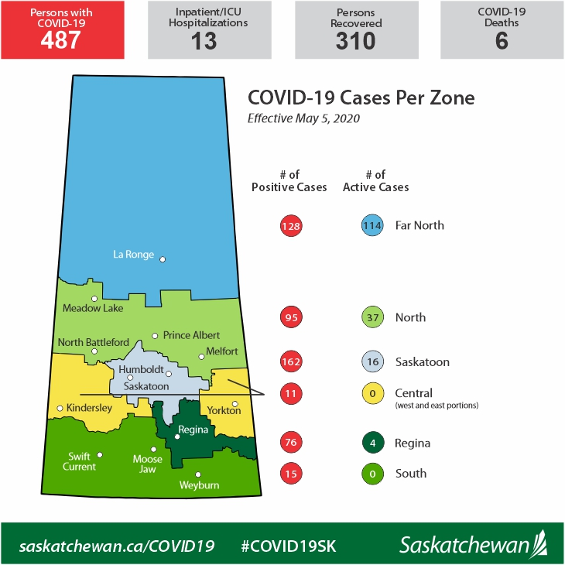
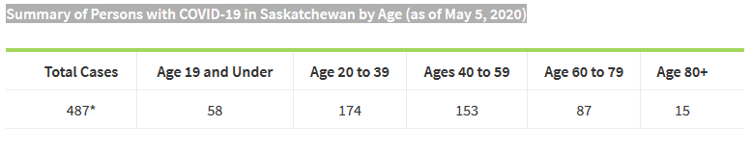
What about Saskatchewan?
Notes:
As of May 5, there were 487 cases in the province, with 171 active cases presently and 6 deaths. Of the 171 active cases, 114 are in the far north and 37 in the north, highlighting the current outbreak that has evolved in the north of the province over the past week.

Slide 21
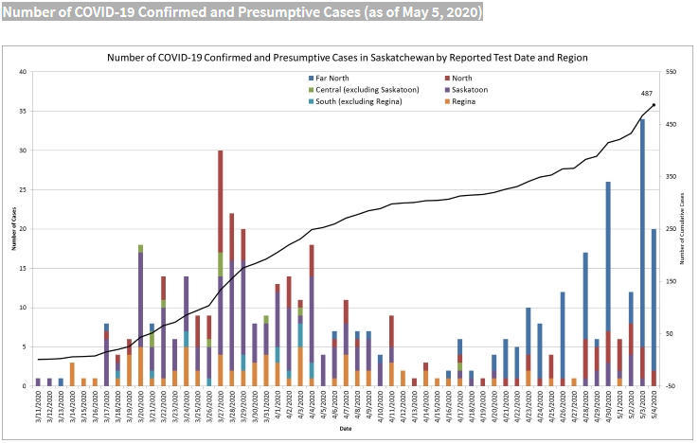
Number of COVID-19 Cases as of May 5, 2020
Subdivided by region of the province per day
Notes:
There has been an undulation to our case curve with increased daily cases at the end of March, leading to a steeper slope, followed by a reduction in daily cases in mid April, causing a levelling of the curve. And now with the outbreak in the northern half of the province, we are seeing another rise in daily cases with a change in slope…
R in Saskatchewan is 0.97 as of May 2. Up from 0.7 earlier. This is what influenced the Saskatchewan Government’s decision to release the Reopen Saskatchewan Plan.

Slide 22
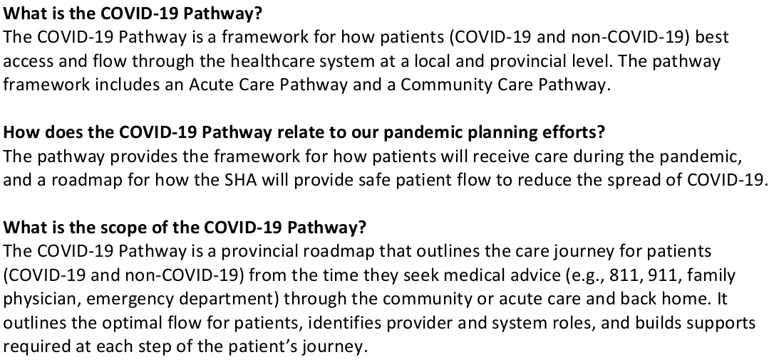
How has Saskatchewan Organized its Delivery of Care?
COVID-19 Pathway

Slide 23
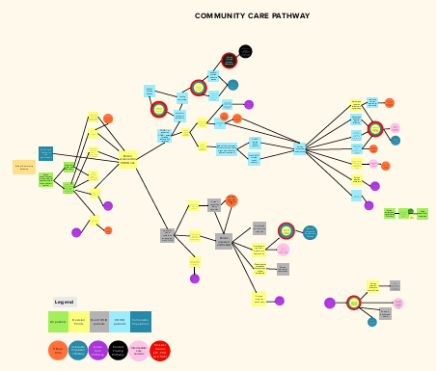
Community Care Pathway

Slide 24
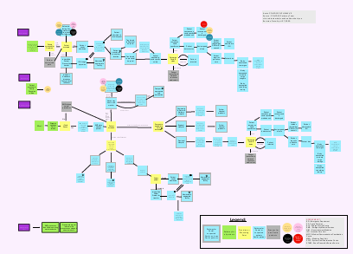
Acute Care Pathway

Slide 25
Research and Clinical Delivery Systems have an enormous role to play in key areas
Prevention
Diagnosis
Treatment
Containment
Long term outcomes
Costs
Notes:
Prevention – development of new vaccine
Diagnose it – is there a more rapid, excellent diagnostic performance (high sensitivity), serologic test to identify immunity, novel sample collection (saliva, NP versus OP, blood)
Containment – Screening algorithm, testing capability, contact tracing, isolation policy effectiveness, Personal protective equipment access and effectiveness,
Treatment – Effective, safe, accessible drugs, Non pharmacological
Long term outcomes – mortality, hospital system usage (admissions, ICU), long term health impact of survivors(lung function, productivity), what about outcomes of our non-covid patients (delays in care, limits on tests, access to drugs)
Costs – COVID related costs, opportunity costs of spending on COVID

Slide 26
What are the costs associated with COVID-19?
Health System
Direct care costs in acute care, LTC, community care
Non COVID care
Personal
Job loss
Mental health
Economy
Closure of businesses
Manufacturing of goods for export
Indirect costs including worker absenteeism (exposure, stress, illness)
Opportunity costs
Relationships
Ability to import
Limits on Tourism and travel
Education
Leisure activities
Absenteeism due to self isolation or illness
Caregiving
Safety net expenditures
Bail outs
Notes:
Direct care costs can include costs of screening, testing, isolation, PPE, hospitalization, drugs, rehab,

Slide 27
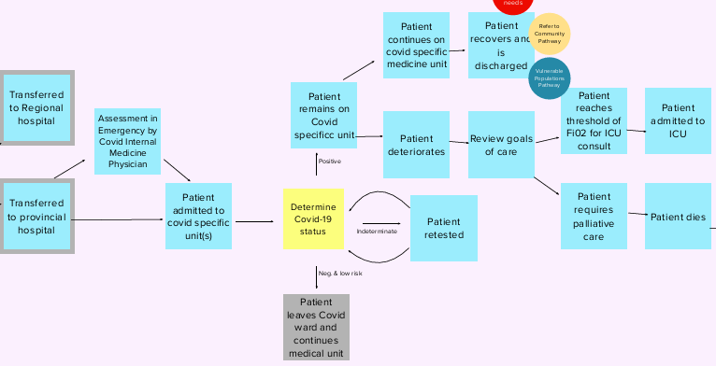
COVID Medicine Care
Notes:
One area that I am involved in clinically is the COVID Medicine Units in our acute care facilities in Saskatoon.
We had to organize our delivery of care to patients in the hospital a little differently during the pandemic in order to protect patients as well as healthcare workers.
We established 2 COVID units at Royal University Hospital and St. Paul’s Hospital. These COVID units are essentially cohorting patients who are confirmed or suspected of COVID on designated units and floors of each hospital. Patients who are screened positive for risk factors for COVID and tested for COVID are placed on isolation and then are placed on these units under the care of an internal medicine physician or occasionally other clinicians (surgeons). When tests return back negative, patients can then be moved to other units in the hospital under different care providers.

Slide 28
What is the cost of care associated with the new COVID medicine pathway compared with usual care?
Supplies: Private rooms with droplet/contact plus precautions
  Gown, gloves, mask, eyewear (shield or goggles)
  If AGMP, then N95 mask is required in addition to above
Time spent donning and doffing
Time spent with patient
Time with allied staff (PT, OT, SW)
Tests ordered
Transfers to other units
Length of stay
Costs
COVID +
COVID -
Usual care

Slide 29
What will we plan to do with these results?
Will use a micro-costing approach to collection of resource use and costs
We will estimate average daily costs associated with patient admission to hospital for COVID suspect, confirmed and usual care patients
Use estimates as inputs into models assessing budget impact of COVID pathway
Explore cost impact of modifications to the COVID pathway
Combine our results with reports of outcomes from the pathway to assess cost-effectiveness of the pathway (Dollars spent per healthcare worker exposure)

Slide 30
Other research in this area?
With an attack rate of 20%, there would be 53.8 million (95% UI: 52.2–55.3 million) symptomatic COVID-19 cases in the U.S.
Costing $163.4 billion (95% UI: $154.5–$173.1 billion) in direct medical costs including only costs occurring during the course of the infection
Including costs for a year post-discharge, cases cost a median of $214.5 billion (95% UI: $202.4–$227.9 billion)
Health Affairs, April 2020

Slide 31
The Big Cost
Health System
Direct care costs in acute care, LTC, community care
Non COVID care
Personal
Job loss
Mental health
Economy
Closure of businesses
Manufacturing of goods for export
Indirect costs including worker absenteeism (exposure, stress, illness)
Opportunity costs
Relationships
Ability to import
Limits on Tourism and travel
Education
Leisure activities
Absenteeism due to self isolation or illness
Caregiving
Safety net expenditures
Bail outs

Slide 32
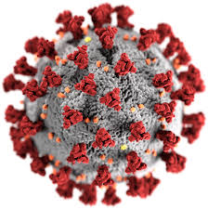
Discussion and Questions

Slide 33
Supplemental slides

Slide 34
Demographic Characteristics
Based on detailed information reported to PHAC for 30721 cases
Highest proportion of cases are among those aged 40-59 years (32%), followed by 20-39 years (26%). 5% of cases occurred in individuals <=19 years of age
Coronavirus Disease 2019. Daily Epidemiological Update. May 3, 2020

Slide 35
Clinical Characteristics
Coronavirus Disease 2019. Daily Epidemiological Update. May 3, 2020

Slide 36
Case Severity
Coronavirus Disease 2019. Daily Epidemiological Update. May 3, 2020
Notes:
Of the 20065 cases with hospitalization data reported, 3148 (16%) reported hospitalization, including 753 (24%) admitted to ICU.
Those aged >=60 years have the highest proportion of reported hospitalizations (66%), ICU (63%), and deaths (95%).
Of the 3148 cases that were hospitalized, 74% reported one or more pre-existing conditions.
Male cases appear to have a somewhat higher risk of hospitalization (1.4 times), and ICU admission (2.0 times) compared to female cases

