Slide 1




Unconscious Bias
Sean Polreis
Admissions Interviewers
www.usask.ca
Notes:
This session is for Admissions training for MMI Interviewers. My contact was Dr. Trustin Domes & Sherrill Bueckert (she attended the full Cook Ross session). 20-30 minutes. It has been modified a bit in early 2021 to create a 30 minute virtual asynchronous resource for Admissions – updated & re-recorded December 2023.
For preparation a Word document was sent out as suggested reading/viewing.
It included a short article/opinion piece from AAMC on their website (Rooting out implicit bias in admissions)
https://www.aamc.org/news-insights/insights/rooting-out-implicit-bias-admissions ).
A very short interview with Howard Ross telling his personal experience with implicit bias (https://www.youtube.com/watch?v=KVp9xCmDqPs).
A link to the Harvard Implicit Association Test.
& an 11 minute video; Countering Bias in the Interview; https://www.youtube.com/watch?v=GRDHXJ5cO1U .
Below is for the longer session done for Family Medicine
Play “Walking in Memphis” for the 5-10 minutes leading up to the session’s start. Prepare in advance.
Resources; Cognitive Biases Word doc; Clerkship objectives; CanMEDS FM (especially professionalism); Cognitive Error reading list;
Load Mr. D video clip;
Could use some version of the Privilege Walk in this workshop too (ex: https://www.youtube.com/watch?v=hD5f8GuNuGQ).
Article “Checking our privilege an important exercise” by Craig & Marc Kielburger (co-founders of the WE movement; we.org). They finish the article with this quote; “Checking privilege isn’t about guild or shaming. We’d say it’s one of the highest forms of self-improvement. In tackling our own hidden biases, we’re not just becoming better people – we’re crating a more just and equitable society”
Also from that article; “If you’re aware of privilege, you can be aware of biases, and that has an impact on how you treat the rest of the world”, Jade Pichette.

Slide 2
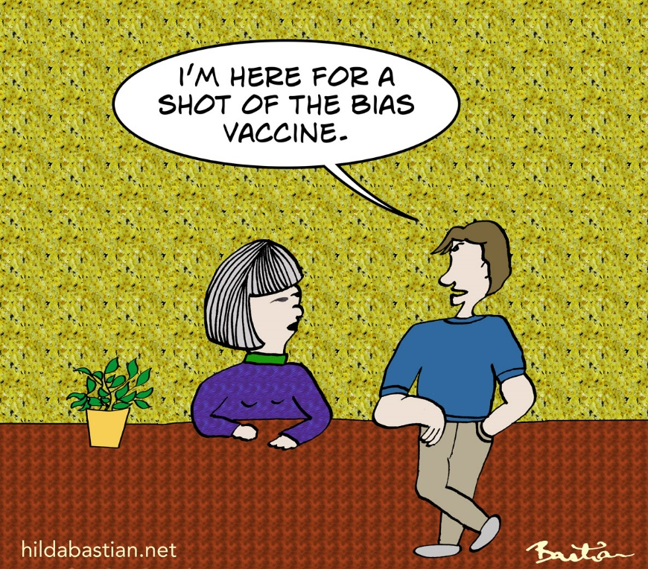
Faculty/Presenter Disclosure
None
All images are attributed, PP stock, copied with permission, or from istockphoto.com
Creative Commons © Hilda Bastian

Slide 3
Objectives
Describe unconscious bias & explain its biological & socio-cultural origins.
Describe a variety of biases that impact our decision-making.
Improve decision-making through an awareness of your biases.

Slide 4
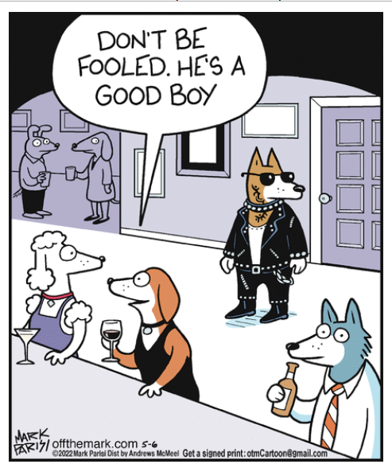

Why important?
Bias can prevent us from making the best & most accurate decisions
Bias can impact our communication
Fairness & transparency
© Andrews McMeel Syndication; Off the Mark by Mark Parisi; 5/6/2022
Notes:
2/25/2023 – Dilbert is cancelled from most newspapers.

Slide 5
Selector/interviewer judgments
Cognitive process is multifaceted
  Social milieu
  Interactions interviewer-candidate
  First impressions
  Characteristics of the task
  Context
  Emotions
  Values
Content courtesy Dr. Gomez-Garibello Zoom webinar; Nov. 2020
Notes:
We will be discussing some of these. Content from CAME Zoom To Entrust or Not to Entrust, That is the Competence Question; Dr. Gomez-Garibello from McGill; November 17, 2020.

Slide 6

1st feeling
Happy
Gluttony
Full
Comfort
Coercive
Pleasure
Thrilled
Strong
Charitable
Hungry
Excited
Dangerous
Influential
Privilege
Speedy
Impactful
Powerful
Sad
Joyful
Satisfaction
Disgusted
McDonald’s logo icon courtesy Pixel Icons on IconScout
Notes:
We have stories about people who are like us & people who are not like us (Melissa Crum’s example was Disney movie villains with British accents)
Since they are our stories we have the power to edit them – “biases are the stories we internalize that we create or are created for us” Melissa Crum.
Put up a familiar logo like McDonald’s or Facebook & ask “what do you think of when you see this?” Ask them to write down the first 3 words.
We see an image; we interpret what it means to us; story we hold (i.e. it is simply a blue “f”, a logo, but we all have unique stories about it)
Nobody’s story is “correct” or the only one that’s valid. These associations are our biases.
Bias cannot be eliminated – the objective is to account for it & try to reduce its impact on decisions.

Slide 7
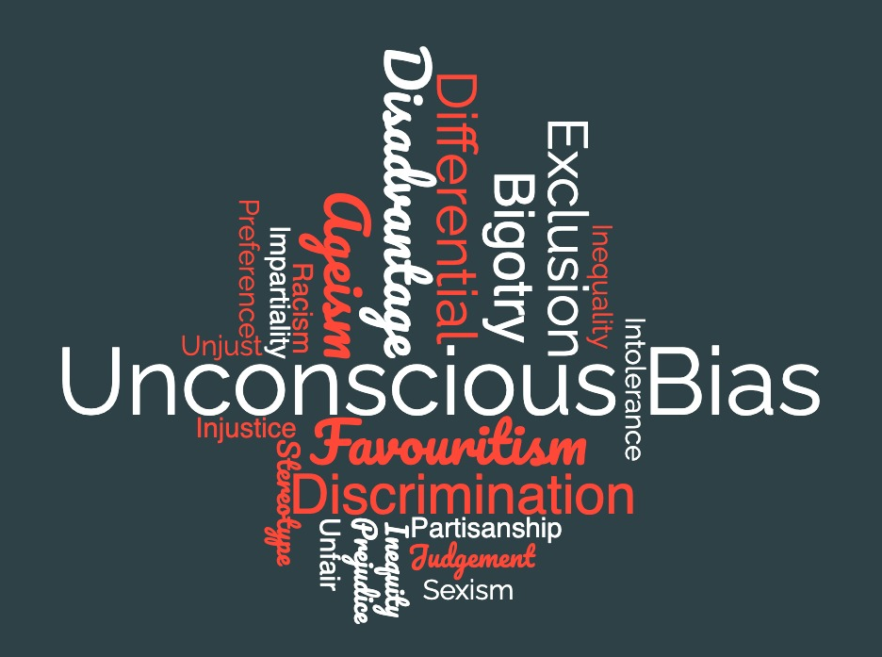
1) Definition
Notes:
If we were to play word association with the word “bias”, this is what we might find. However, while bias can lead to many of these things, that isn’t how we will define it.
Quickly discuss the definition in light of popular meanings attributed to the word & how our definition might differ.
It does not mean you are a racist or a bad person if you have bias – it just means you’re human.
Shift from guilt to responsibility.
This is why I dislike terms like “stopping/preventing” bias; “debiasing”; “anti-bias” training; supressing stereotypes; giving up bias; colour blindness; etc.

Slide 8
AAMC* Definition
Without intention or control
“Unconscious [everyday] also known as implicit bias, refers to attitudes or stereotypes that are outside our awareness but nonetheless affect out understanding, our interactions, & our decisions.”
Automatic (pre-reflective)
*Association of American Medical Colleges
Notes:
Quickly describe the difference between explicit/conscious & implicit/unconscious bias (use my sports teams for an example of explicit bias – pro Red Sox; anti Yankees). There are also institutional biases – built into the structure of an organization.
By themselves, biases are not good or bad or right or wrong – they just “are”. No moral attachment.
Conscious egalitarian beliefs may not align with unconscious bias.
Phelps, E. A., O'Connor, K. J., Cunningham, W. A., Funayama, E. S., Gatenby, J. C., Gore, J. C., & Banaji, M. R. (2000). Performance on indirect measures of race evaluation predicts amygdala activation. Journal of cognitive neuroscience, 12(5), 729-738. Study looked at evaluations & representations of social groups & how they differ – black/white. Great study to support the following; amygdala response (& eyeblink startle response) is connected to measures of unconscious bias (IAT); in contrast there is no connection between physical responses (amygdala & eyeblink startle response) & direct or conscious white/black racial bias (used the Modern Racism Scale); the variability in response is (at least somewhat) a “result of culturally acquired knowledge about social groups filtered through individual experiences.”
There are definitions of bias that use the terms “unreasonable”, “hostile”, “opinion”, “prejudice” etc. This is the definition from the AAMC.
There is no intention, awareness, or control. “You will not walk out of here in an hour with less bias”
From Verna Myers TED Talk – “biases are the stories we make up about people before we know who they actually are”.
Bias = pattern recognition/shortcuts. We use this all the time.

Slide 9

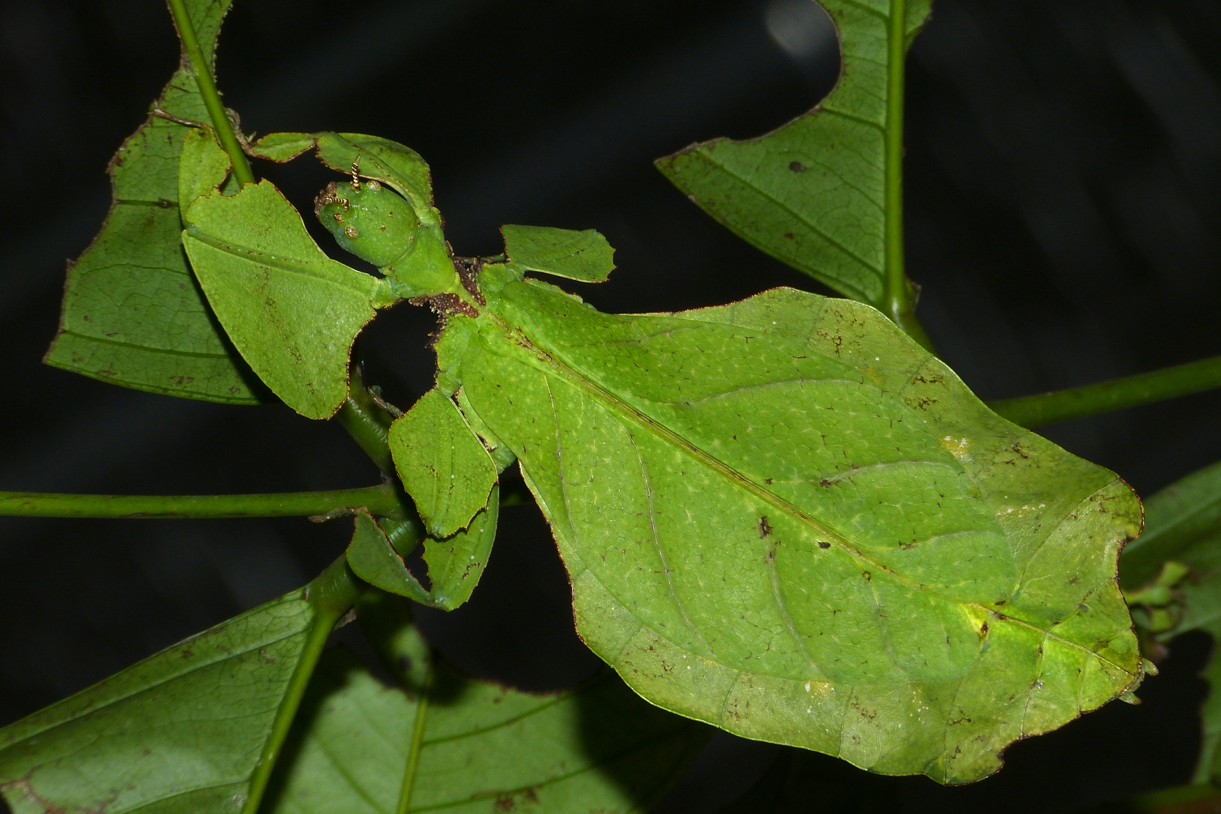




Plants?
Wikimedia Commons
Automatic association or assumption
Notes:
Our automatic associations help us identify things quickly & they are often correct, but not always. The circled image is a Giant Leaf Insect. Our brains default to categorization.
A quick non-human example of an unconscious bias. You can usually bring an unconscious bias to consciousness.

Slide 10
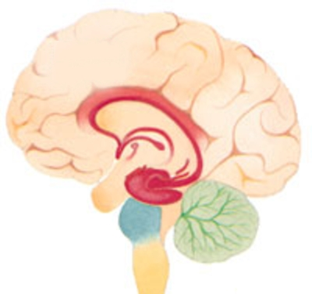
Biology of bias
Automatic brain
Amygdala
Hippocampus
Hypothalamus
Deliberate brain
Neocortex
Unconscious bias comes from here (pre-reflective)
Notes:
An important point is that in reality, these different systems of thinking (System 1 & System 2) work together. Also, it’s not true that error is always due to automatic thinking. It actually functions quite well much of the time. Daniel Kahnemann.
With some audiences, ask for definitions or functions of these areas of the brain. Amygdala – processes emotions, fight or flight; Hippocampus – memory formation & recall; Hypothalamus – body temperature & hormone release. These areas produce impressions & feelings & move the body to respond. They help us survive. Fast & emotional part of the brain.
Neocortex (or more specifically the prefrontal cortex) is home of higher order brain functioning – cognition, language, sensory perception, spatial reasoning, problem solving. Slow & thinking part of the brain.
Pragya Agarwal discusses the role of the amygdala in unconscious bias.
Reinforce the point that it is impossible not to have bias – it is normal, natural, & unstoppable.
It starts early – studies on children as young as 5!
Familiar = comfort = safety. We are hard wired to make meaning & seek patterns “cells that fire together, wire together” from Hugh Vasquez webinar.
**Phelps, E. A., O'Connor, K. J., Cunningham, W. A., Funayama, E. S., Gatenby, J. C., Gore, J. C., & Banaji, M. R. (2000). Performance on indirect measures of race evaluation predicts amygdala activation. Journal of cognitive neuroscience, 12(5), 729-738. Study looked at evaluations & representations of social groups & how they differ – black/white. Great study to support the following; amygdala response (& eyeblink startle response) is connected to measures of unconscious bias (IAT); in contrast there is no connection between physical responses (amygdala & eyeblink startle response) & direct or conscious white/black racial bias (used the Modern Racism Scale); the variability in response is (at least somewhat) a “result of culturally acquired knowledge about social groups filtered through individual experiences.”
In humans, the amygdala's role extends beyond fear conditioning to the expression of learned emotional responses that have been acquired without direct aversive experience (Funayama, Grillon, Davis, & Phelps, in press; Phelps, LaBar, et al., 1998). The amygdala is necessary for learning responses to social and emotional signals.

Slide 11
Where do our biases come from?
Experiences
  Real life, movies, books, games, media, education, etc.
Culture
  Broad & sub-culture groups (ex: urban/rural)
  Identities (ex: music, hobbies, beliefs, etc.)
Context
  Place & time
Notes:
Use some examples for these. Highlight that if institutions/structures in society have bias/discrimination they can become a part of our own biases.
Some specific examples will follow on next few slides in part 2. Ask them to start thinking about their own for part 2 – exploring our own biases.

Slide 12
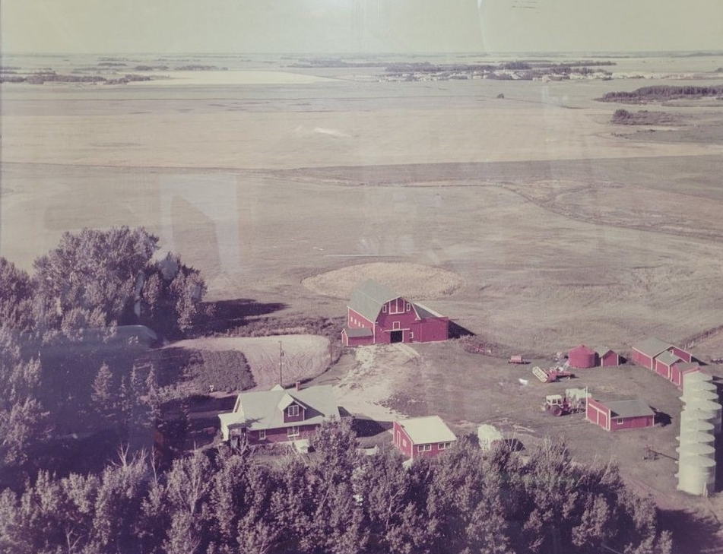
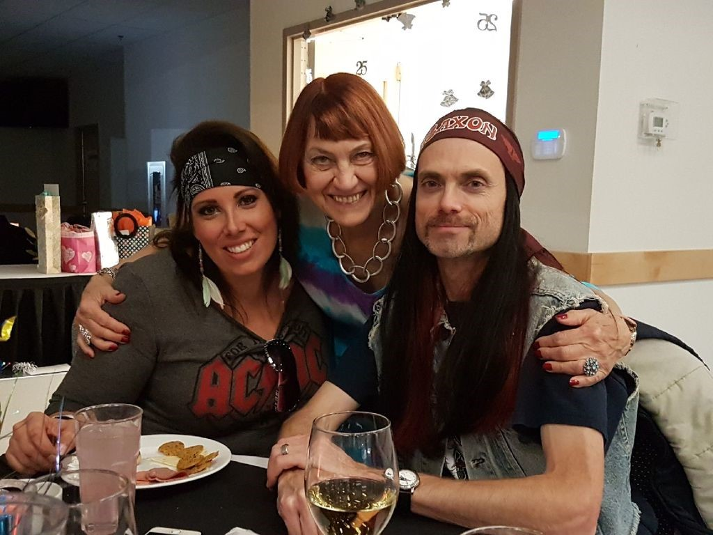

My experiences growing up
Image courtesy Annaheim Rec Board Facebook Page

Slide 13
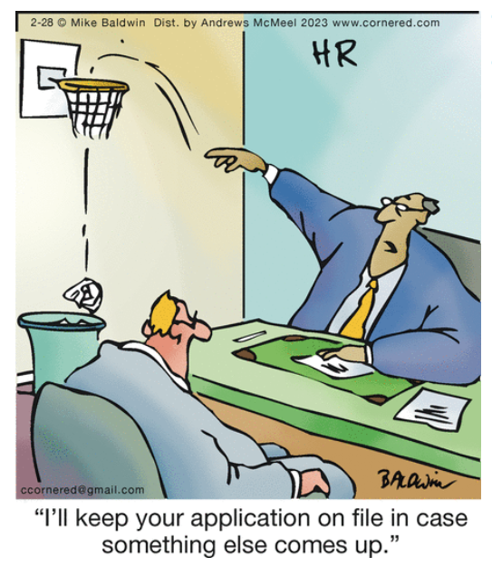
Experiences
© Andrews McMeel Syndication; Cornered by Mike Baldwin; 2/28/2023
Notes:
Using examples specific to the interview process here.
Previous experiences with interviews may influence your automatic associations with interviews.

Slide 14

Culture
What are your associations with this posture?
Can you think of other possible cultural influences?
Notes:
Handshake as greeting is a common (pre-COVID) Western cultural expectation. Remember a bias is an association.
Other common Western cultural biases are around importance of time & written history.
Think about other cultural associations we have that might impact the interview process. For example, perceptions of bragging/boasting. If self-promotion is valued, a person may present as more confident &/or competent to someone else from that culture. They may present as obnoxious to someone from a different cultural background. The interviewer & interviewee both come with cultural baggage – we need to be careful not to make associations that might not be accurate.
Personal example: When the Pope visited in Canada in 2022 to apologize for harms to Indigenous people, among many things that many people were unhappy with, one that I hadn’t considered – Catholics believe in apologies & forgiveness as a standard way of correcting a wrong. I grew up Catholic & had this same assumption – not considering that some cultures may have very different belief systems (& in fact do of course).
For a full description of this, see “Sometimes, the word sorry is not enough”, Allison Hanes, Montreal. https://montrealgazette.com/opinion/columnists/allison-hanes-sometimes-the-word-sorry-is-not-enough.
Some languages have no word for “sorry”. Acts of repentance needs to produce a tangible act in order for an apology of value. To some, the Pope’s apology was “one-sided, is offered on the ‘perpetrators’’ terms, puts the onus on Indigenous people to heal & is rooted in the Catholic doctrine of granting forgiveness when requested.” Wahehshon Whitebean (Mohawk) said “in our language, we do not have a word for sorry … culturally, we’re taught we have to make our wrongs right. You have to do everything in your power to make everything right when there’s a wrong.” For many, words alone are insufficient to make up for these atrocities; words must be followed up with action.

Slide 15

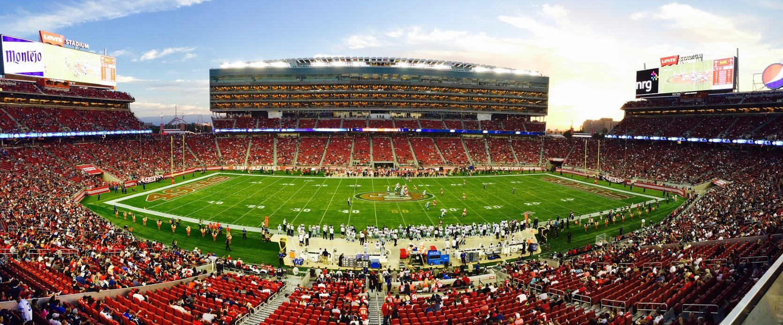
Context
Different association in terms of dress, language, courtesy, etc.
Image courtesy pixabay

Slide 16

What does a doctor look like?

Slide 17

Surgeon riddle
Notes:
Very important point – unconscious biases don’t necessarily align with one’s explicit, conscious views of the world. For example, someone with egalitarian views may still have an unconscious bias that is expressed.
Reference the old riddle - a father and son are in a horrible car crash that kills the dad. The son is rushed to the hospital; just as he’s about to go under the knife, the surgeon says, “I can’t operate—that boy is my son!” Explain.
Share Dr. Nassrein Hussein’s experience (if she consents) – she told her husband & son the riddle & “the best they could come up with is that the child had 2 dads”.
Belle, D., Tartarilla, A. B., Wapman, M., Schlieber, M., & Mercurio, A. E. (2021). “I Can’t Operate, that Boy Is my Son!”: Gender Schemas and a Classic Riddle. Sex Roles, 1-11.
“Having an employed mother or female physicians, identifying as a feminist or a political liberal, and reporting low levels of sexism did not predict the realization that the surgeon in the riddle could be a woman. Only identifying as female predicted a greater likelihood of this response. Only 30% of participants were able to transcend stereotyped gender schemas and realize that a surgeon could be a woman and a mother. Explicitly expressed egalitarian beliefs do not guarantee objective, accurate perceptions and treatment of others. Rather, our perceptions of others are strongly influenced by the nonconscious beliefs we all hold about gender differences. Considering the increased prevalence of female surgeons, both in real life and in media representations, the difficulty many of the study’s participants had in envisioning a female surgeon illuminates the inertia of powerful and pervasive gender schemas. To remember the riddle yet forget its solution (1/3 of participants remembered hearing the riddle before) suggests again how deep such gender schemas lie. Although the high number of responses suggesting same-sex parents as a solution to the riddle may indicate plasticity in schemas in response to changes in the socio-political climate, it also highlights by contrast the resistant nature of gender schemas. The current results suggest that gender schemas continue to influence problem-solving, despite one’s personal beliefs, values, or life experiences.”

Slide 18

Surgeon riddle
There’s a man and his son in a car crash. The father is killed & the son rushed to hospital. The duty surgeon says: ‘I can’t operate; that boy is my son!’
Belle, D., Tartarilla, A. B., Wapman, M., Schlieber, M., & Mercurio, A. E. (2021). “I Can’t Operate, that Boy Is my Son!”: Gender Schemas and a Classic Riddle. Sex Roles, 1-11.
Notes:
Reference the old riddle - a father and son are in a horrible car crash that kills the dad. The son is rushed to the hospital; just as he’s about to go under the knife, the surgeon says, “I can’t operate—that boy is my son!” Explain.
Share Dr. Nassrein Hussein’s experience (if she consents) – she told her husband & son the riddle & “the best they could come up with is that the child had 2 dads”.
Belle, D., Tartarilla, A. B., Wapman, M., Schlieber, M., & Mercurio, A. E. (2021). “I Can’t Operate, that Boy Is my Son!”: Gender Schemas and a Classic Riddle. Sex Roles, 1-11.
“Having an employed mother or female physicians, identifying as a feminist or a political liberal, and reporting low levels of sexism did not predict the realization that the surgeon in the riddle could be a woman. Only identifying as female predicted a greater likelihood of this response. Only 30% of participants were able to transcend stereotyped gender schemas and realize that a surgeon could be a woman and a mother. Explicitly expressed egalitarian beliefs do not guarantee objective, accurate perceptions and treatment of others. Rather, our perceptions of others are strongly influenced by the nonconscious beliefs we all hold about gender differences. Considering the increased prevalence of female surgeons, both in real life and in media representations, the difficulty many of the study’s participants had in envisioning a female surgeon illuminates the inertia of powerful and pervasive gender schemas. To remember the riddle yet forget its solution (1/3 of participants remembered hearing the riddle before) suggests again how deep such gender schemas lie. Although the high number of responses suggesting same-sex parents as a solution to the riddle may indicate plasticity in schemas in response to changes in the socio-political climate, it also highlights by contrast the resistant nature of gender schemas. The current results suggest that gender schemas continue to influence problem-solving, despite one’s personal beliefs, values, or life experiences.”

Slide 19
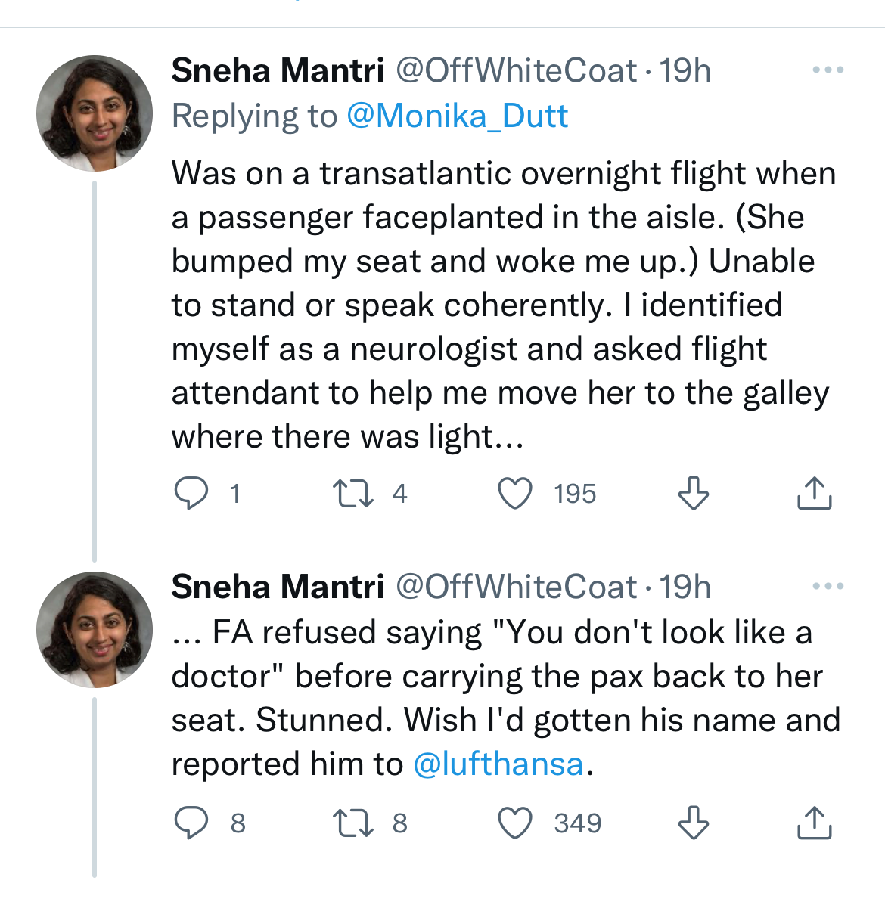
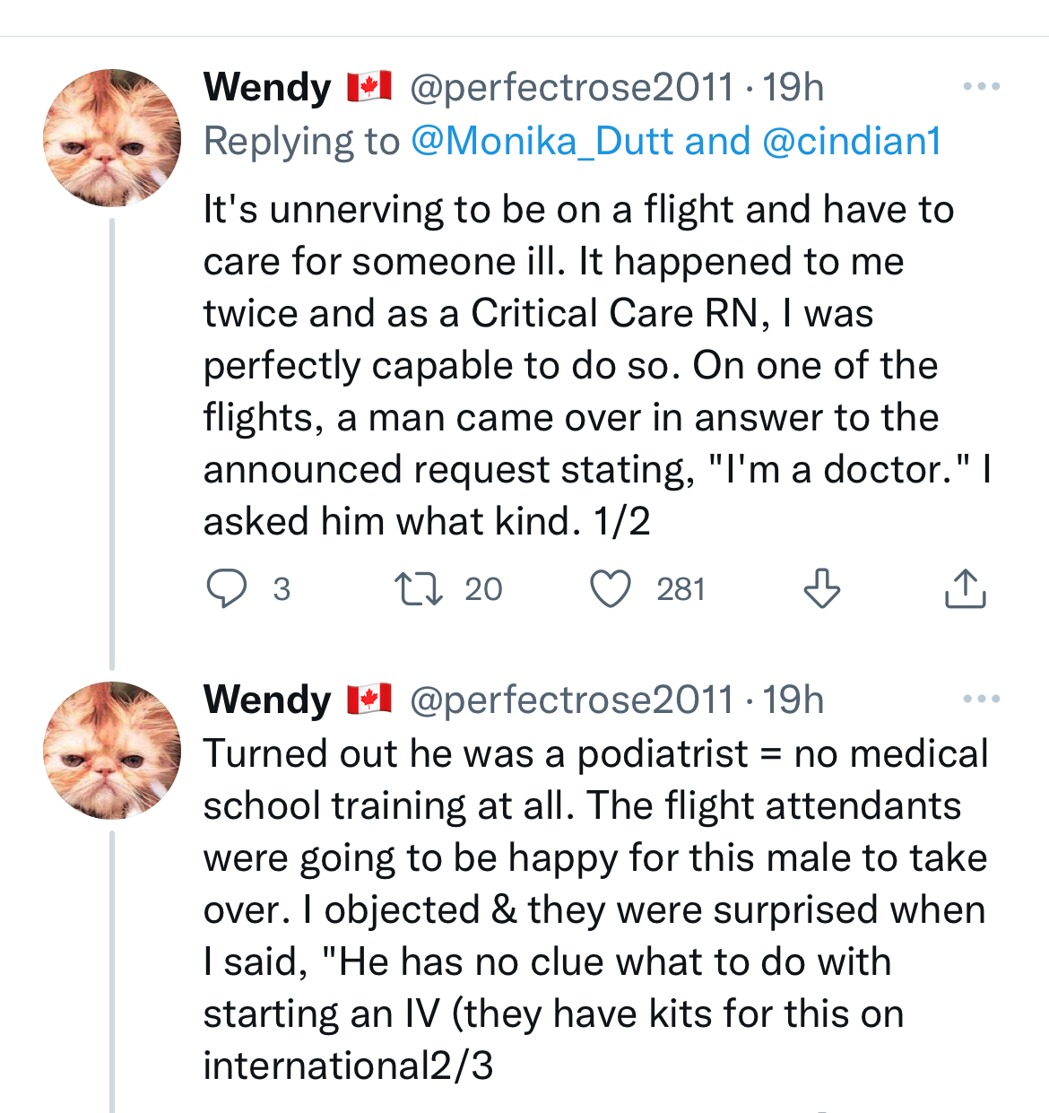
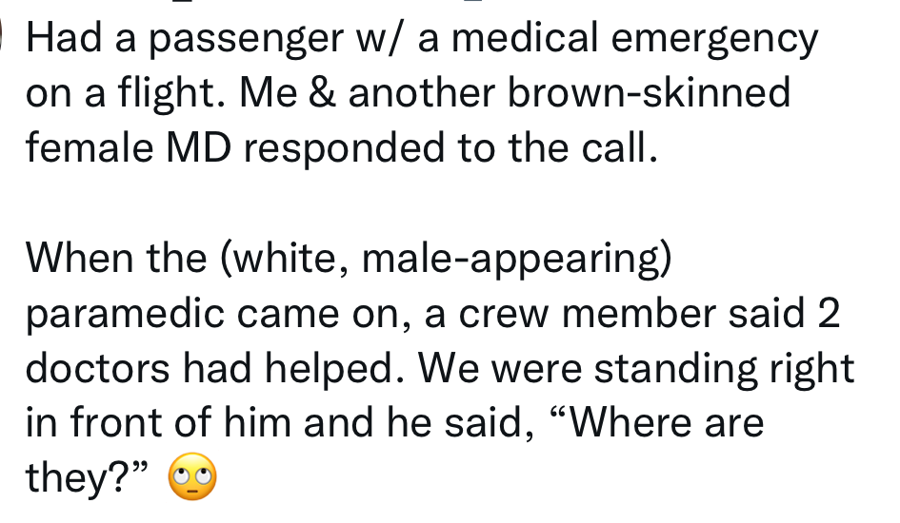
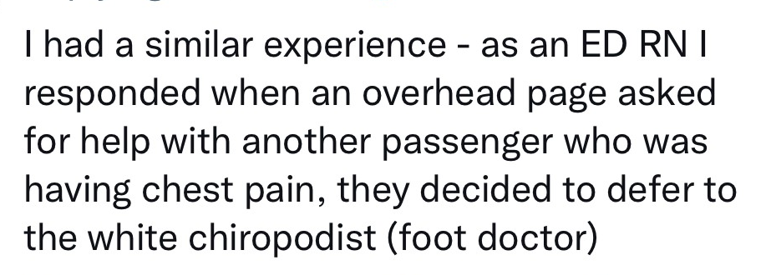
What does a doctor look like?
Notes:
Twitter thread from August 2022 – doctors discussing assumptions about their competence/qualifications based on appearance.
Could use for affect heuristic or microaggressions too.

Slide 20

Who do you think is the “ideal” doctor?
Previous clinical experiences
Traditional educational path vs. non-traditional
Valuable life experiences
Family situation
Gender & ethnicity
Notes:
Our expectations & perceptions may influence our decisions.
#1 example – lots of previous shadowing.
For last point, reference the old riddle - a father and son are in a horrible car crash that kills the dad. The son is rushed to the hospital; just as he’s about to go under the knife, the surgeon says, “I can’t operate—that boy is my son!” Explain.
Belle, D., Tartarilla, A. B., Wapman, M., Schlieber, M., & Mercurio, A. E. (2021). “I Can’t Operate, that Boy Is my Son!”: Gender Schemas and a Classic Riddle. Sex Roles, 1-11.
“Having an employed mother or female physicians, identifying as a feminist or a political liberal, and reporting low levels of sexism did not predict the realization that the surgeon in the riddle could be a woman. Only identifying as female predicted a greater likelihood of this response. Only 30% of participants were able to transcend stereotyped gender schemas and realize that a surgeon could be a woman and a mother. Explicitly expressed egalitarian beliefs do not guarantee objective, accurate perceptions and treatment of others. Rather, our perceptions of others are strongly influenced by the nonconscious beliefs we all hold about gender differences. Considering the increased prevalence of female surgeons, both in real life and in media representations, the difficulty many of the study’s participants had in envisioning a female surgeon illuminates the inertia of powerful and pervasive gender schemas. To remember the riddle yet forget its solution (1/3 of participants remembered hearing the riddle before) suggests again how deep such gender schemas lie. Although the high number of responses suggesting same-sex parents as a solution to the riddle may indicate plasticity in schemas in response to changes in the socio-political climate, it also highlights by contrast the resistant nature of gender schemas. The current results suggest that gender schemas continue to influence problem-solving, despite one’s personal beliefs, values, or life experiences.”

Slide 21
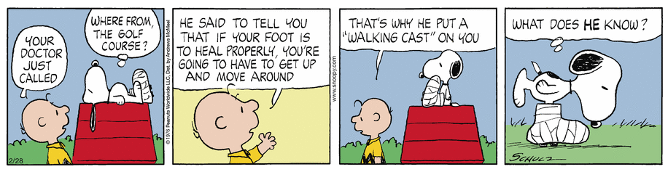
Our unconscious biases are shaped by all our experiences
© Andrews McMeel Syndication; Peanuts by Charles Schulz; 2/28/2023
Notes:
This doctor is a male which is typically assumed. Also that he is a golfer. Common stereotypes which are perpetuated by comics like this. These kinds of representations shape how we see doctors.

Slide 22

2) Impacts (types)
MMI, panel interviews, conversation circles
Notes:
Changes to admissions process in 2023. Indigenous students considered through the Indigenous Admissions Circle will only do the Conversation Circle in 2024 (in 2023 they did both Panel Interview & Conversation Circle. Also, for the Conversation Circle there are only 2 options – “recommend” & “not recommend”. 2 circle members fill out one score sheet – combined effort.

Slide 23
How does unconscious bias influence behaviour?
Voice inflection
Non-verbal communication (ex: eye contact, smiling, physical proximity, etc.)
Types of questions you ask
Types of comments you make
Demeanor
Time spent
Notes:
An example already used was the study (one of many) showing responses to email differed based on gender & ethnicity of the name.
Greenwald, A. G., & Banaji, M. R. (1995). Implicit social cognition: Attitudes, self-esteem, and stereotypes. Psychological Review, 102, 4–27. This study was the reason for creating the IAT – the knowledge that social behaviour often operates in unconscious fashion.
McConnell, A. R., & Leibold, J. M. (2001). Relations among the Implicit Association Test, discriminatory behavior, and explicit measures of racial attitudes. Journal of experimental Social psychology, 37(5), 435-442.
FitzGerald, C., & Hurst, S. (2017). Implicit bias in healthcare professionals: a systematic review. BMC medical ethics, 18(1), 19. More about patient-physician interactions & diagnostic decisions but easily transferrable to this context.
Elliott, A. M., Alexander, S. C., Mescher, C. A., Mohan, D., & Barnato, A. E. (2016). Differences in physicians' verbal and nonverbal communication with black and white patients at the end of life. Journal of pain and symptom management, 51(1), 1-8. In this small regional sample, hospital-based physicians have similar verbal communication behaviors when discussing end-of-life care for otherwise similar black and white patients but exhibit significantly fewer positive, rapport-building nonverbal cues with black patients (ex: distance from patient, open body language, touching patient).
Kang, J., Dasgupta, N., Yogeeswaran, K., & Blasi, G. (2010). Are ideal litigators white? Measuring the myth of colorblindness. Journal of Empirical Legal Studies, 7(4), 886-915. IAT & the connection to behavior.
Chen, M., & Bargh, J. A. (1997). Nonconscious behavioral confirmation processes: The self-fulfilling consequences of automatic stereotype activation. Journal of Experimental Social Psychology, 33(5), 541-560.
Fazio, R. H., Jackson, J. R., Dunton, B. C., & Williams, C. J. (1995). Variability in automatic activation as an unobtrusive measure of racial attitudes: A bona fide pipeline?. Journal of personality and social psychology, 69(6), 1013.
Stivers, T., & Majid, A. (2007). Questioning children: Interactional evidence of implicit bias in medical interviews. Social Psychology Quarterly, 70(4), 424-441.
Note Jerry Kang has a TED Talk (I have a screen shot in my bias resources) with a slide with several studies showing the link between implicit bias & behaviour.

Slide 24

Nonverbal communication
Elliott, A. M., Alexander, S. C., Mescher, C. A., Mohan, D., & Barnato, A. E. (2016). Differences in physicians' verbal and nonverbal communication with black and white patients at the end of life. Journal of pain and symptom management, 51(1), 1-8.
Notes:
In this small regional sample, hospital-based physicians have similar verbal communication behaviors when discussing end-of-life care for otherwise similar black and white patients but exhibit significantly fewer positive, rapport-building nonverbal cues with black patients (ex: distance from patient, open body language, touching patient).

Slide 25

Howard Ross’s experience
Notes:
Video file embedded – can play directly from here.

Slide 26
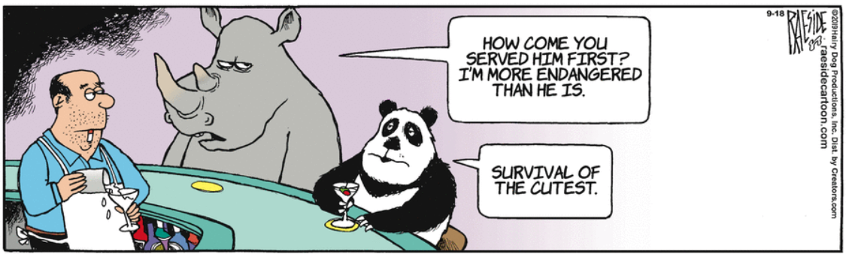
Affect heuristic bias
“1st impression” (positive or negative) feelings in relation to a stimulus
What stimuli are leading to the bartender bias?
© The Other Coast, Adrian Raeside, 9/18/2019
Notes:
Decisions heavily influenced by your emotions. “gut feeling” bias. This one basically describes unconscious/everyday/implicit bias.
Heuristic is a shortcut that allows us to make decisions quickly & efficiently.
Warmth & competence are 2 primary things we immediately look for in people. Automatically. Much social psychology research in this area.
A fun study to illustrate this one is the influence of in-store music on wine selection. When French music was played, more French wine was purchased. When German music, more German wine. 2 week study, music alternated day to day. Customers were unaware of the effect.
North, A. C., Hargreaves, D. J., & McKendrick, J. (1999). The influence of in-store music on wine selections. Journal of Applied psychology, 84(2), 271.
There are dozens/hundreds of types of bias.
Ask what is the stimulus leading to the bias demonstrated in the cartoon. Attractiveness is the specific stimulus playing out here. This is an example of taxonomic bias – more attention (research, government, & public) given to certain animals.

Slide 27



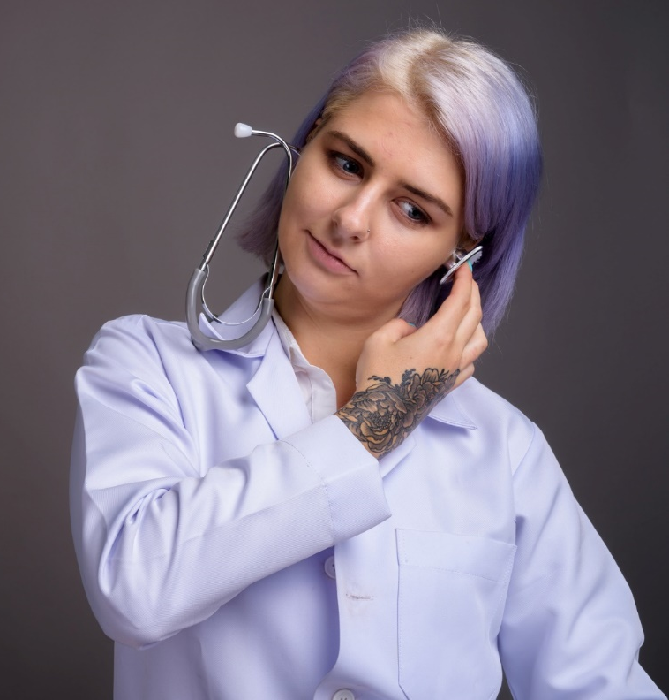

Any “gut” feelings?
Notes:
Ask them to think of all the things that may be influencing their gut feeling & feelings of warmth & competence about these doctors.

Slide 28
Affect heuristic bias – ex: of stimuli
What are some factors that may influence how we feel about someone or something?
Notes:
Heuristic is a shortcut that allows us to make decisions quickly & efficiently.
Brainstorm with the group a list of things that might influence a person’s affective heuristic bias. I.e. “when you meet someone, what things might come into play for this”? I have 16 on the slide – things that might influence me on whether I think someone is warm/competent.
Might want to break this down into categories of stimuli? Appearance, weather, smell, time of day, etc.

Slide 29
Affect heuristic bias – ex: of stimuli
Attractiveness
Gender
Ethnicity
Age
Clothing
Name
Piercings
Tattoos
Speech
Smell
Voice/accent
Sexual orientation
Posture
Facial expression
Handshake
Hair style
Notes:
Others for this list: disability, location, accent, weight, name, introversion/extroversion, social class, etc.
Decisions heavily influenced by your emotions. “gut feeling” bias. This one basically describes everyday/implicit bias.
Heuristic is a shortcut that allows us to make decisions quickly & efficiently.
Warmth & competence are 2 primary things we immediately look for in people. Automatically.
Might want to break this down into categories of stimuli? Appearance, weather, smell, time of day, etc.

Slide 30
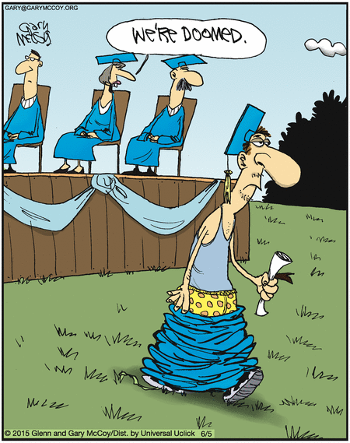
What stimuli are influencing this comment?
©
Notes:
Quick quiz #2 – answer, likely dress, facial expression; facial hair.

Slide 31
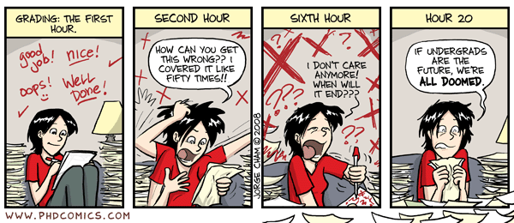
Norm-referencing bias & availability heuristic
© Jorge Cham, PHDCOMICS, 2019
Notes:
Norm-referencing bias (AAMC video calls this contrast effect) - comparing applicants to those coming before or after them.
Availability heuristic – placing more value on first idea that comes to mind (which may come to mind for a variety of reasons – the above as well as affect heuristic bias would be two common reasons).
From AAMC - Contrast effects: Comparing one applicant with the performance of previously interviewed applicants. The order in which the applicants are interviewed can affect the ratings they are given. While making ratings, interviewers should refrain from comparing applicants. Instead, interviewers should focus on evaluating each applicant’s response in relation to the rating scale.

Slide 32
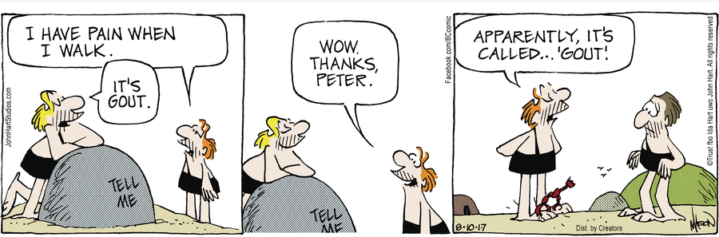
Anchoring
Reprinted by permission of John L. Hart FLP. © 8/10/2017
Notes:
Anchoring – overly influenced by an early piece of information (“first impression”). A failure to adjust initial prognoses on the basis of later information, or a failure to modify initial diagnoses because of new events.
Adame, B. J. (2016). Training in the mitigation of anchoring bias: A test of the consider-the-opposite strategy. Learning and Motivation, 53, 36-48.

Slide 33
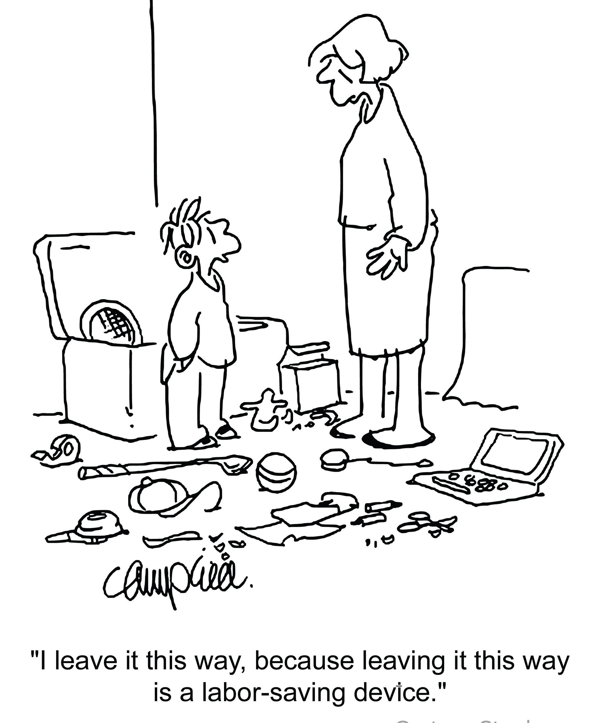

Halo & horns effect
© CartoonStock
Notes:
In this comic, if there was a halo effect, the child could be seen as a creative problem solver; if there was a horns effect, a lazy, messy, disorganized procrastinator.
The feeling you get from some responses influences your perception of other responses. Importance of the first few minutes of an interview (“first impression”).
From AAMC - Halo/Horns effect: Allowing ratings of performance based on one response to influence ratings for another response. For example, allowing a rating on a question assessing teamwork to influence the rating on a question assessing motivation. Also similar to primacy/recency – using how you feel about a previous answer to influence the following answer.
MacDougall, M., Riley, S. C., Cameron, H. S., & McKinstry, B. (2008). Halos and Horns in the Assessment of Undergraduate Medical Students: A Consistency-Based Approach. Journal of applied quantitative methods, 3(2), 116-128.

Slide 34
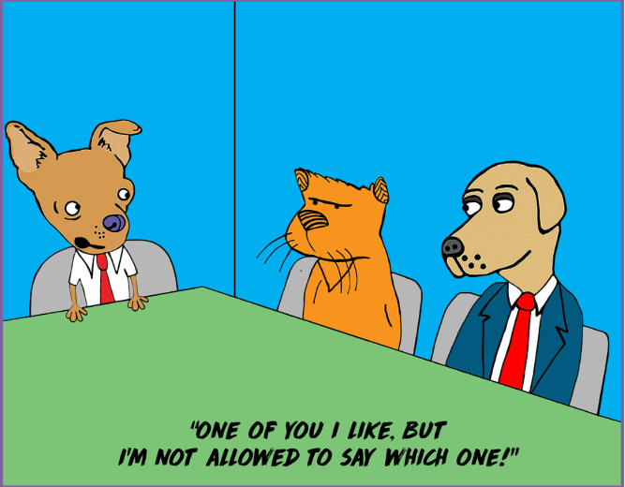
Affinity (similar-to-me) bias
© Shutterstock
Notes:
Favouring those who are more similar to ourselves (or to people we know & like). Common interests can be very influential.
This cartoon shows a gender bias which can be part of this type of bias.
Personal example from April, 2022; AJ Hinch, Detroit Tigers manager, decides to start the season with 3 catchers on the roster. It is rare – announcers thought it might be due to a bit of “catcher bias” since Hinch was a catcher when he played.
May, G. L. (2008). The effect of rater training on reducing social style bias in peer evaluation. Business Communication Quarterly, 71(3), 297-313. (also relevant to halo)

Slide 35
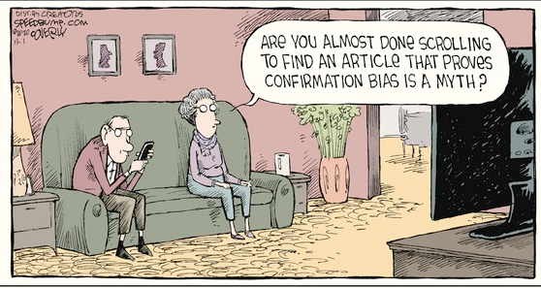
Confirmation bias
Dave Coverly; Speed Bump © 11/1/2020, Permission of Universal Uclick
Notes:
This bias can build on any of the previous ones – placing more value on information that supports your existing belief. We notice, remember, & interpret behaviour that reinforces our beliefs.

Slide 36
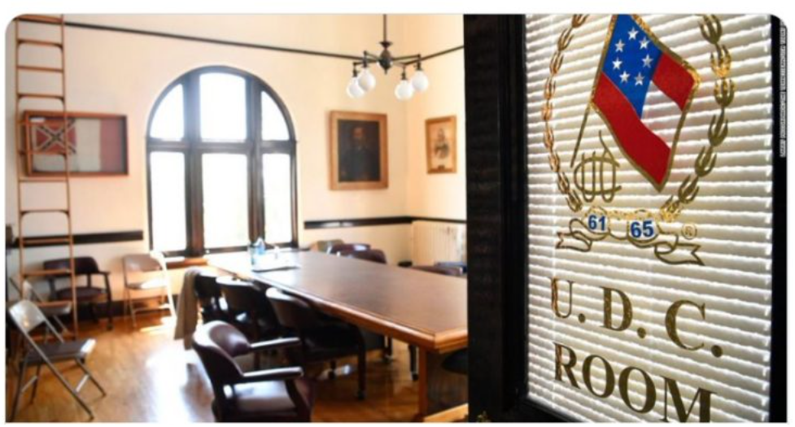
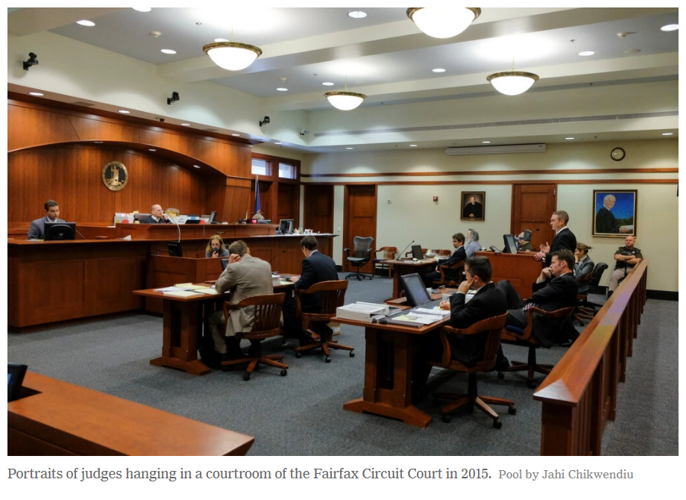
Unconscious bias in the courtroom
Fairfax Circuit Court, Virginia
© 1/1/2021; New York Times
© 12/8/2021
@Hola_Mars Twitter Screengrab/CNN
Giles county courthouse, Tennessee
Notes:
This slide was used earlier as an example of how unconscious bias works – just remind them now that actions were taken to make these rooms less likely to influence the bias of people in them.

Slide 37

Virtual interviews
Notes:
Use one of these video clips to demonstrate professional unplanned interruptions.
Children interrupt BBC News Interview (https://www.youtube.com/watch?v=Mh4f9AYRCZY) – 43 seconds.
Global News; ''Rocco, put your tail down": Cat interrupts virtual UK parliamentary meeting (https://www.youtube.com/watch?v=4pq9N8qrTT0) – 74 seconds but only need the first 50 seconds or so.
“REP. SHALALA'S DOG, FAUCI, BARKS & FUSSES THROUGH CNN INTERVIEW” - https://www.tmz.com/videos/2020-12-19-121920-dog-fauci-4901280/. First 30 seconds or so will do it. Go to 1:19 & that gets to the back story on the dog’s name.

Slide 38
Virtual interviews
Technological
  Quality of equipment (web camera, microphone, software)
  Quality of connection (stable internet access)
  Tech savviness of candidate
Patience & giving adequate time important
Notes:
Virtual backgrounds might be important if the room is messy or disorganized – but they may cause issues with bandwidth

Slide 39
Virtual interviews
Environment/setting*
  Artwork, paintings, pictures, etc.
  Virtual background
  Other people (lack of privacy)
  Noises – kids, pets, construction, etc.
  Lighting
Facial expressions & voice may be prominent (less ability to look for body language cues)
*AAMC video: Addressing Implicit Bias in Virtual Interviews
Notes:
May even be in a very different environment like a vehicle.
With voice it may be tone (pleasant – think Gilbert Gottfried or Bobcat Goldthwaite), or accent.
Body language cues being reduced may actually be good for bias.

Slide 40
Groups experiencing negative biases?
Introverts
Indigenous
Rural
MMI Performance
Notes:
Introverts may take more time to respond while extroverts share thoughts & feelings more easily & seem to thrive in groups more – there is a well recognized (but not too well studied) societal bias favouring extroverts. Society implicitly favours extroversion.
Jerant study (references) found extraversion was associated to higher MMI performance. ‘Warmth’ perception may be higher or occur faster?
BEME systematic review (in references slide) speaks to Aboriginal & rural students’ performance in MMI.
Raghavan study (references) showed graduation from a rural high school was significantly associated with decreased MMI scores
New research from McMaster (unpublished as of May 2023) indicates the presence of unwarranted social biases associated in medical school admissions systems, which negatively impacts access to the profession for aspirants via the intersection of age, race, gender, & socioeconomic status. https://fammed.mcmaster.ca/evaluating-bias-in-medical-school-admissions-tools/.

Slide 41
3) Improving communication & decision-making
Policy level
Individual level
Notes:
Quick quiz – answer is gender (likely not a question he would ask a man). So from a policy standpoint we try to do things in the system to help reduce bias.
This is one of the reasons for standardized/structured interview questions. Strategy in terms of policy/system to help overcome individual bias.
We try to control for bias with our systems – for example, the MMI – multiple samples/stations, multiple assessors, standardized questions/structured interviews, etc.
Unstructured interviews are too prone to bias. In a Medicine School example, at the University of Texas Medical School at Houston, students initially rejected for medical school performed the same as those students initially accepted.
DeVaul, R. A., Jervey, F., Chappell, J. A., Caver, P., Short, B., & O'Keefe, S. (1987). Medical school performance of initially rejected students. JAMA, 257(1), 47-51.
Business world example – Google & Slack have begun to use structured interviews to avoid discrimination in hiring.

Slide 42
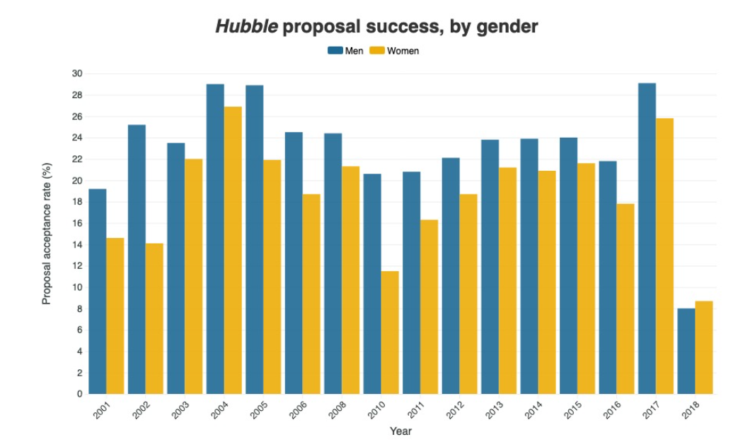
Policy level
Strolger, L., & Natarajan, P. (2019). Doling out Hubble time with dual-anonymous evaluation. Physics Today.
Notes:
Ask them to guess what happened in 2018. From 2001 to 2017 Hubble observing proposals led by men (blue) had better success rates than those led by women (yellow). 2018 a dual-anonymous, double blind review system was implemented. No time was allocated in 2007 & 2009.
NASA now addressing gender, ethnic, & institution (those from small research institutions) bias.
Just 1 quick example of unconscious bias & how it can be reduced at the policy level. At this stage in their careers, this won’t be as relevant, but they can start looking for ways to reduce the possibility of bias in systems.

Slide 43
Policy level
Standardization – structured interviews (MMI or behaviour-based interviews)
  While accounting for cultural differences (ex: conversation circles)
Training for consistency
Clearly defined criteria & scoring rubrics
Multiple assessment methods
Diverse pool of interviewers
September, 2016; AAMC; Best Practices for Conducting Residency Program Interviews
Notes:
“The MMI interview style has gained support as studies have demonstrated that performance does not seem to be impacted by gender, family income level, size of community of origin, or ethnicity.” From - Girgulis, K., Rideout, A., & Rashid, M. (2019). Performance of Black and Indigenous applicants in a medical school admissions process. Canadian Medical Education Journal. The citation for this comment is the article below.
Jerant A, Fancher T, Fenton JJ, et al. How medical school applicant race, ethnicity, and socioeconomic status relate to multiple mini-interview-based admissions outcomes: findings from one medical school. Acad Med. 2015;90(12):1667-1674.
Langhan, M. L., Goldman, M. P., & Tiyyagura, G. (2022). Can behavior-based interviews reduce bias in fellowship applicant assessment?. Academic Pediatrics, 22(3), 478-485. “BBIs were successfully implemented and generally reviewed positively by faculty and applicants. BBIs reduced racial differences in applicant assessments.”

Slide 44

2 circle members fill out 1 score sheet
Notes:
2 conversation circle members fill out one score sheet. An example of an Admissions policy to help reduce the impact of bias.

Slide 45

Acknowledgement, acceptance, & awareness
Interrupt from exclusively determining our decisions & behaviours
Mitigation not elimination
Notes:
All about disruption – not elimination.
Important to note that our biology makes unconscious biases inevitable but they have socio-cultural sources (i.e. they are learned) which means we can address them & alter our actions.
Awareness involves self-audit (who are my friends & contacts; who do I think of when someone mentions, pilot, doctor, engineer, etc.?)
Acceptance means not denying that we have these biases.
A recent (2019) study showed that an awareness of gender bias had a positive impact on promoting women by scientific evaluation committees. Committees that did not explicitly believe that women faced external barriers, promoted fewer women. Real world study United States wide in a variety of scientific fields.
Régner, I., Thinus-Blanc, C., Netter, A., Schmader, T., & Huguet, P. (2019). Committees with implicit biases promote fewer women when they do not believe gender bias exists. Nature human behaviour, 3(11), 1171-1179.

Slide 46
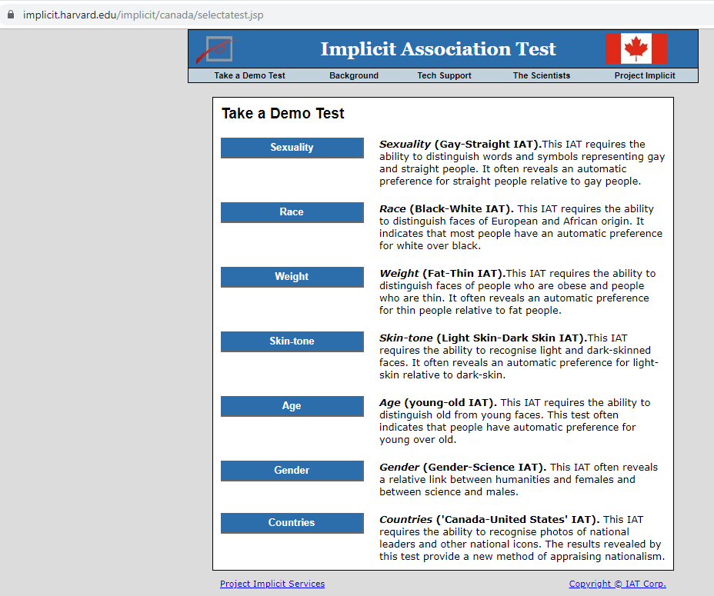
Take an Implicit Association Test
Capers IV, Q., Clinchot, D., McDougle, L., & Greenwald, A. G. (2017). Implicit racial bias in medical school admissions. Academic Medicine, 92(3), 365-369
Notes:
Awareness involves self-audit (who are my friends & contacts; who do I think of when someone mentions, pilot, doctor, engineer, etc.?). What are my biases?
Acceptance means not denying that we have these biases.
Harvard IAT - https://implicit.harvard.edu/implicit/canada/takeatest.html
Flower-Insect Test - https://implicit.harvard.edu/implicit/user/agg/blindspot/indexfi.htm
Note the IAT is not a measure of bias & is not indicative of intent (no need to share results). It’s an awareness raising tool to facilitate thought & discussion.
From Capers IV, Q., Clinchot, D., McDougle, L., & Greenwald, A. G. (2017). Implicit racial bias in medical school admissions. Academic Medicine, 92(3), 365-369. Ohio State University College of Medicine.
“Following the implicit bias exercise and the subsequent admissions cycle, nearly half of the committee members reported agreement with the statement “when I interview candidates, I have my individual IAT results in mind,” and nearly a quarter reported that their knowledge of their individual IAT scores had an impact on their evaluation of candidates. While a causal relationship cannot be proven, in the admissions cycle immediately following the implicit bias exercise, the committee selected the most diverse class in the college’s history. Thus, taking the IAT can be an important exercise in self-awareness for medical school admissions committees.”
Awareness alone seems to have an impact on behaviour.
A recent (2019) study showed that an awareness of gender bias had a positive impact on promoting women by scientific evaluation committees. Committees that did not explicitly believe that women faced external barriers, promoted fewer women. Real world study United States wide in a variety of scientific fields.
Régner, I., Thinus-Blanc, C., Netter, A., Schmader, T., & Huguet, P. (2019). Committees with implicit biases promote fewer women when they do not believe gender bias exists. Nature human behaviour, 3(11), 1171-1179.

Slide 47
Individual level
Awareness of strong reactions for or against a particular applicant or type of applicant
Careful of 1st impressions impacting your assessment & communication
Perspective-taking
September, 2016; AAMC; Best Practices for Conducting Residency Program Interviews
Notes:
Point #3 – empathizing with someone (taking their perspective) decreases unconscious bias.

Slide 48
Interview tips
Behavioural content related to the appropriate competency (not your perception)
Content of response only (not irrelevant information included in response)
Response to given question only (not influenced by previous responses)
Response without reference to other candidates
AAMC webinar; Addressing Implicit Bias in Virtual Interviews
Notes:
These tips help to minimize the influence of bias.
Example from Lori’s Word document – Interview Form. “Tell us about your clinical experiences during training. Specifically, we would like to hear about your procedural skills & obstetrical training”. Lots of other examples “how did you approach this problem?”
The last two are similar to some of the biases we’ve looked at like norm-referencing, anchoring, halo, etc.

Slide 49
Summary
While completely natural (arising from our biology & socio-cultural experiences), our unconscious biases can negatively impact our decision-making & communication
Strategies:
  Awareness & examination of our biases
  Identifying areas where policy decisions can reduce bias
Notes:
We use biases for efficiency & ease but we don’t want important decisions determined this way. Need to be critical & reflective in our judgements.
Reiterate that the point is all about better decision-making.
Perfectly good, open-minded, non-discriminatory people are susceptible to biases.

Slide 50
References
Alweis, R. L., Fitzpatrick, C., & Donato, A. A. (2015). Rater perceptions of bias using the multiple mini-interview format: A qualitative study. Journal of Education and Training Studies, 3(5), 52-58.
Dodson, M., Crotty, B., Prideaux, D., Carne, R., Ward, A., & De Leeuw, E. (2009). The multiple mini‐interview: how long is long enough?. Medical education, 43(2), 168-174.
Harasym, P. H., Woloschuk, W., Mandin, H., & Brundin-Mather, R. (1996). Reliability and validity of interviewers' judgments of medical school candidates. Academic Medicine, 71(1), S40-2.
Jerant, A., Griffin, E., Rainwater, J., Henderson, M., Sousa, F., Bertakis, K. D., ... & Franks, P. (2012). Does applicant personality influence multiple mini-interview performance and medical school acceptance offers?. Academic Medicine, 87(9), 1250-1259.
Raghavan, M., Martin, B. D., Burnett, M., Aoki, F., Christensen, H., MacKalski, B., ... & Ripstein, I. (2013). Multiple mini-interview scores of medical school applicants with and without rural attributes.
Rees, E. L., Hawarden, A. W., Dent, G., Hays, R., Bates, J., & Hassell, A. B. (2016). Evidence regarding the utility of multiple mini-interview (MMI) for selection to undergraduate health programs: A BEME systematic review: BEME Guide No. 37. Medical Teacher, 38(5), 443-455.
Notes:
Dodson – 5 minute MMI as reliable as 8 minute MMI (may demonstrate biases like Halo, anchoring, premature closure).
Harasym – shows significant variability among interviewers (this is pre-MMI).
Jerant – extraversion associated with positive MMI results.
Raghavan – graduation from a rural high school was significantly associated with decreased MMI scores.
Rees BEME systematic review – relates to rural & aboriginal MMI results.
Capers IV, Q., Clinchot, D., McDougle, L., & Greenwald, A. G. (2017). Implicit racial bias in medical school admissions. Academic Medicine, 92(3), 365-369. Admissions committee members at a large, public, Midwestern medical school displayed significant levels of implicit white preference on the IAT
McConnell, A. R., & Leibold, J. M. (2001). Relations among the Implicit Association Test, discriminatory behavior, and explicit measures of racial attitudes. Journal of experimental Social psychology, 37(5), 435-442. Participants with a stronger negative attitude toward Blacks vs Whites (on the IAT) had more negative social interactions with a Black experimenter & reported relatively more negative Black prejudices on explicit measures. Importantly, this study shows that “IAT assesses personal attitudes that relate to social behavior in meaningful ways.” In other words IAT does indeed have predictive utility.
Régner, I., Thinus-Blanc, C., Netter, A., Schmader, T., & Huguet, P. (2019). Committees with implicit biases promote fewer women when they do not believe gender bias exists. Nature human behaviour, 3(11), 1171-1179.

Slide 51

https://medicine.usask.ca/facultydev/

