Slide 1

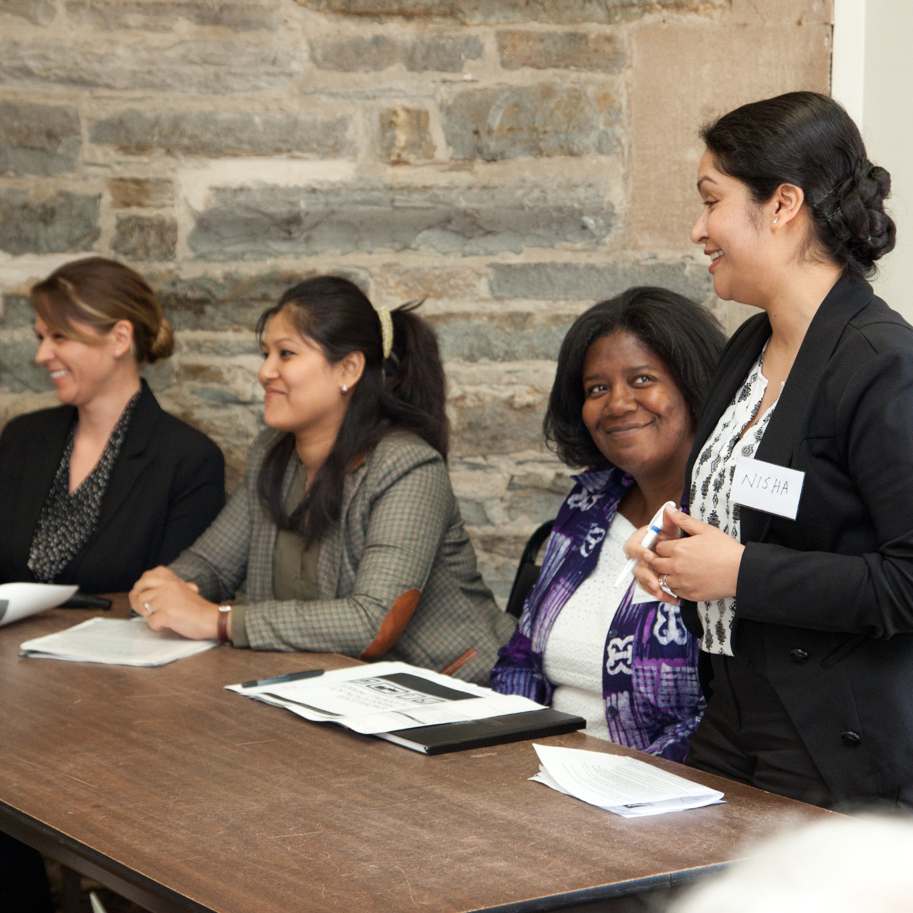


MicroResearch Workshops Faculty Development
Nov 23 – Dec 4
Times TBD
Interested in Community Based Health Research?
Learn how to design and conduct a health research project and how to write a proposal
Research training and support from experienced teachers and one-on-one team coaching
Address health issues within your community by bringing your own ideas to the table
Access to web-based research curriculum for continued learning
Collaborate with other professionals and community members in your area
Opportunity to apply for a research grant to implement your project
Learn how to publish your research results and make a difference in your community!
“MicroResearch was eye-opening. I am positive that it will change my life.”
For more information, visit www.microresearch.ca
To register, contact Kayla at medicinefaculty.development@usask.ca
Educationally approved by Dalhousie University Continuing Professional Development and Medical Education. This activity is an Accredited Group Learning Activity (Section 1) as defined by the Maintenance of Certification Program of the Royal College of Physicians and Surgeons of Canada and approved by Dalhousie University Continuing Professional Development and Medical Education. You may claim a maximum of 36.0 hours (credits are automatically calculated).

